Slide 1
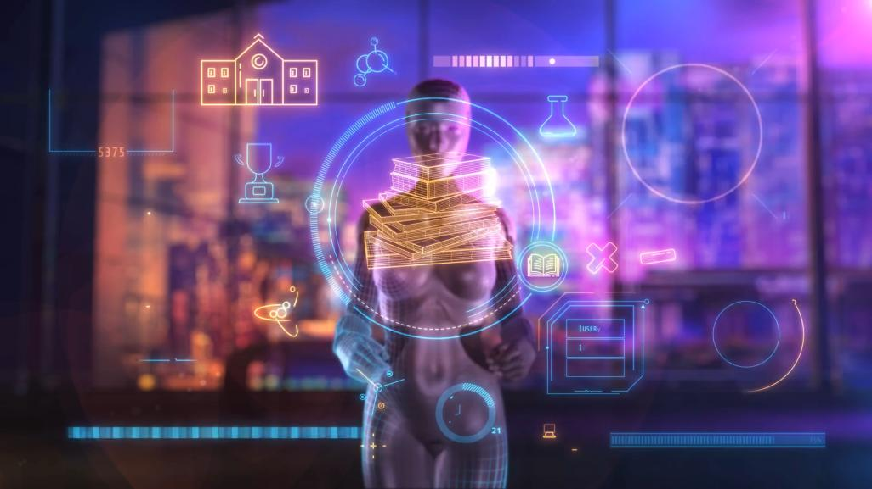
1.目標
Notes:
https://pixabay.com/videos/artificial-intelligence-technology-183107/

Slide 2

2.阻礙
Notes:
https://pixabay.com/videos/tech-laptop-artificial-intelligence-183108/

Slide 3
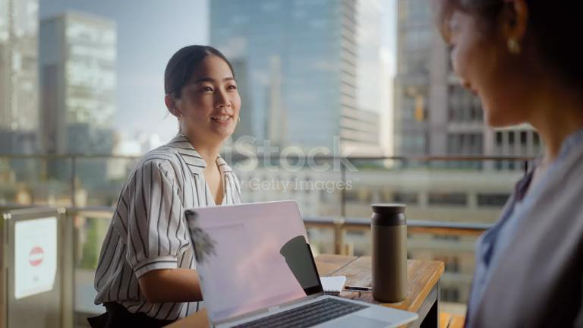
3.努力
Notes:
https://www.istockphoto.com/en/video/two-businesswomen-working-together-outdoors-in-city-gm1323234074-408954703

Slide 4
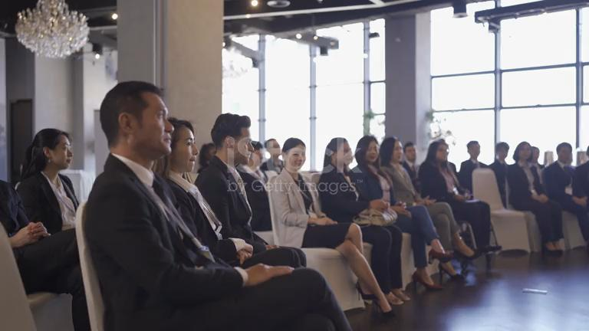
4.結果
Notes:
https://www.istockphoto.com/video/asian-seminar-participants-applauding-listening-to-presenter-on-stage-gm1914234868-554946999?utm_source=pixabay&utm_medium=affiliate&utm_campaign=SRP_video_sponsored&utm_content=https%3A%2F%2Fpixabay.com%2Fvideos%2Fsearch%2Fpress%2520conference%2F&utm_term=press+conference

Slide 5

5.意外
Notes:
https://pixabay.com/videos/court-justice-design-animation-3d-1985/

Slide 6
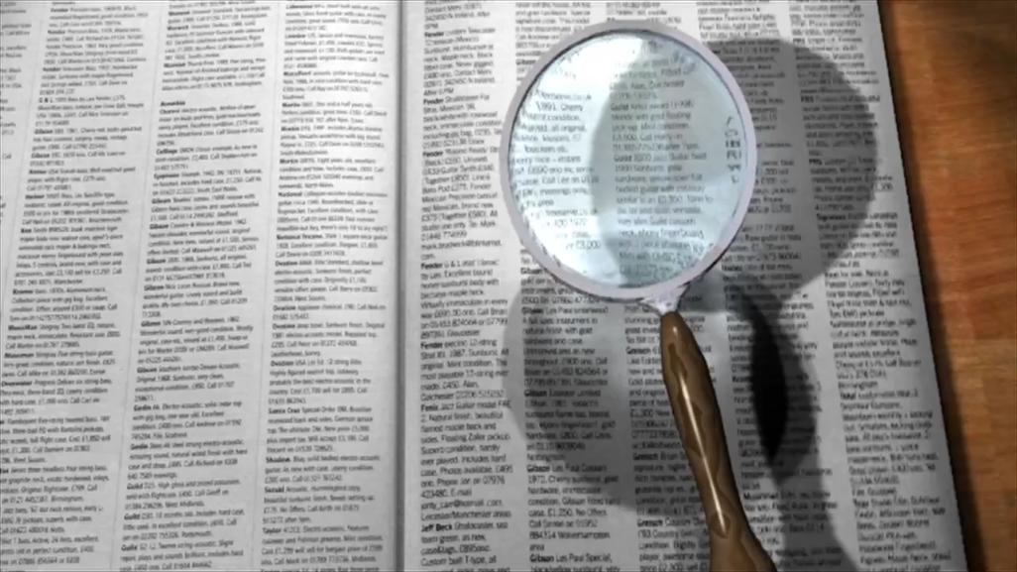
6.轉彎
Notes:
https://pixabay.com/videos/search-book-school-learning-5393/

Slide 7
7.結局
檔案太大傳不到github，所以把最後一張刪掉
Notes:
https://pixabay.com/videos/candles-flame-light-candlelight-112565/

